Slide 1
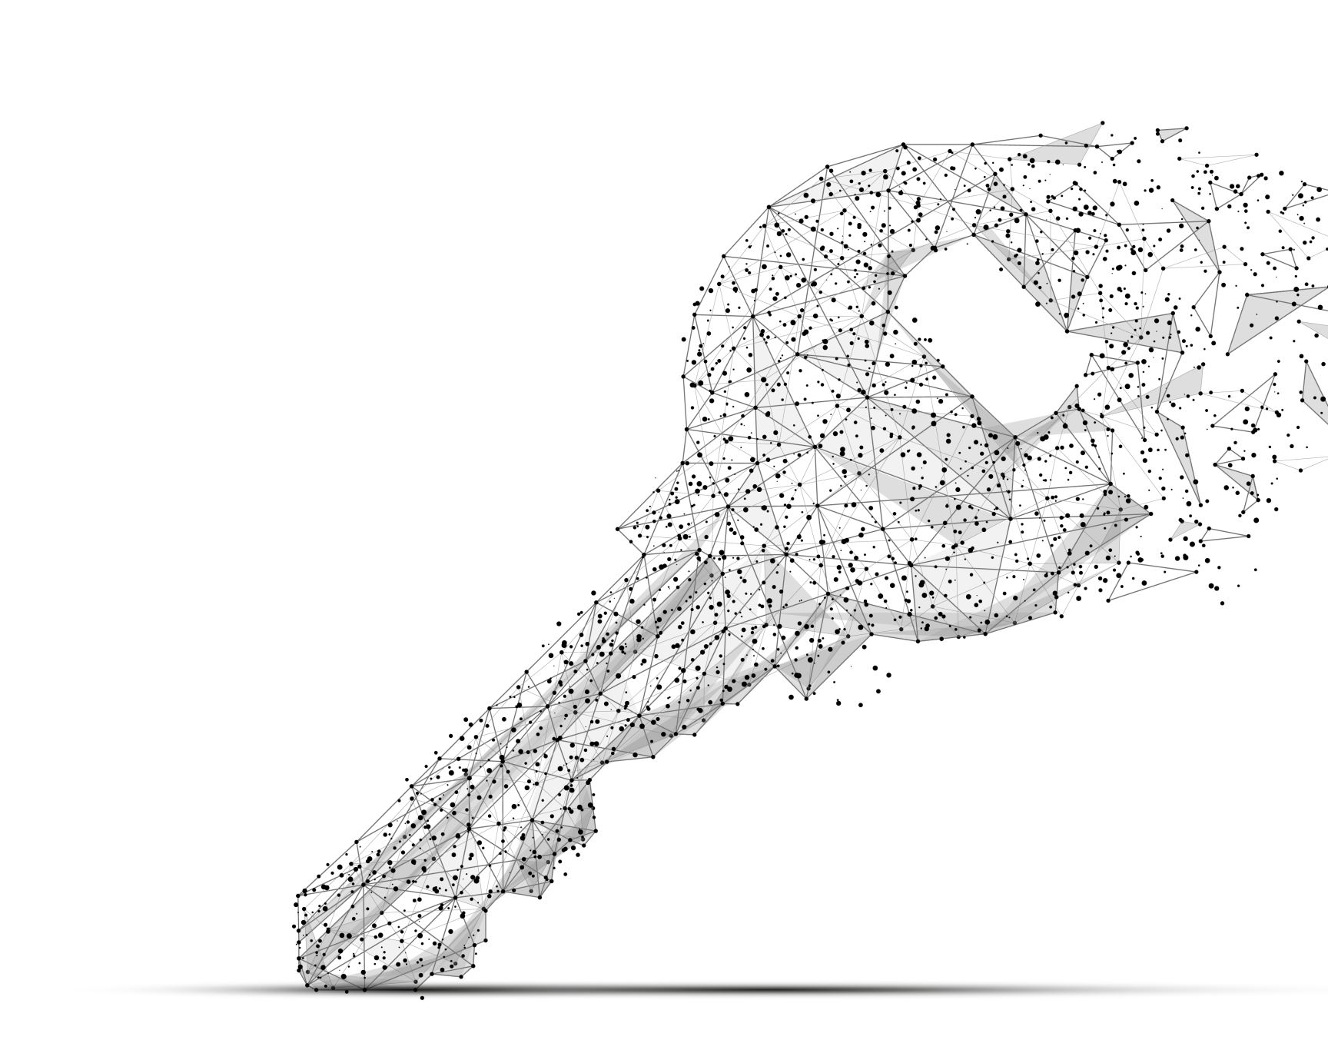
KEYLOGGER
Presented By:
Siddharth T.V
Anjalai Ammal Mahalingam Engineering College
“Information Technology”

Slide 2

OUTLINE :
Problem Statement
Proposed Solution
System Development Approach
Algorithm & Deployment
Result
Conclusion
Future Scope
References

Slide 3

PROBLEM STATEMENT
In today's digital age, where cybersecurity threats loom large, one of the significant concerns is the proliferation of keyloggers, stealthy software tools designed to monitor and record keystrokes on a user's computer without their knowledge. Keyloggers pose a severe threat to individuals and organizations as they can capture sensitive information such as passwords, credit card details, and other personal data, leading to identity theft, financial loss, and privacy breaches.

Slide 4
PROPOSED SOLUTION
Basic Keylogger:
Create a simple keylogger that captures all keystrokes (including special keys) and saves them to a log file. Use the pynput library to listen for key events. Save the captured keys to a text file (e.g., “log.txt”). Implement graceful exit (e.g., stop logging when the Escape key is pressed).
Advanced Features:
Add timestamping to each logged keystroke. Encrypt the log file for security. Implement remote reporting (send logs to a server or email) for monitoring purposes.
Ethical Considerations:
Always use keyloggers responsibly and legally. Obtain proper consent before deploying a keylogger. Educate users about the purpose and scope of monitoring.
Timestamping:
Enhance your keylogger by adding timestamps to each logged keystroke. Use the datetime module to record the exact time when a key was pressed. Include the timestamp in the log file alongside the corresponding key.
Encryption:
Consider encrypting the log file to protect sensitive information. Use encryption libraries (e.g., cryptography) to secure the log data. Encrypt the log content before writing it to the file and decrypt it when needed.

Slide 5

SYSTEM DEVELOPMENT APPROACH
Objective: The primary goal of our keylogger is to capture keystrokes made by the user and log them for further analysis or monitoring.
Key Listener:
We’ll use the pynput library to listen for key events (both key presses and releases).
The key listener will run in the background, capturing keystrokes without disrupting the user’s normal activities.
Data Storage:
We’ll save the captured keystrokes to a log file (e.g., “log.txt”).
Each key press will be recorded along with a timestamp (optional).
User Interface (Optional):
We can create a simple command-line interface (CLI) to start and stop the keylogger.
The user can initiate the keylogger and terminate it when needed..

Slide 6
ALGORITHM
1. Initialization: Start the key logger program and initialize necessary variables.
2. Capture Keystrokes: Continuously monitor keyboard input to detect when keys are pressed.
3. Record Keystrokes: When a key is pressed, record the key itself and the time it was pressed.
4. Stealth Mode (Optional): Implement features to hide the key logger from the user's view, making it discreet.
5. Data Storage: Store the recorded keystrokes securely, ensuring they are not lost.
6. Security Measures (Optional): Apply encryption to the stored data to protect it from unauthorized access.
7. Legal Compliance: Ensure that the key logger complies with relevant laws and regulations regarding user privacy and data collection.
8. Deployment and Monitoring: Deploy the key logger on the target system and monitor its operation to ensure it functions correctly and remains undetected

Slide 7
DEPLOYMENT APPROACH
Local Deployment:
Run the Python script on the local machine where you want to capture keystrokes.
Ensure that the script runs in the background (e.g., minimize the console window).
The keylogger will save all keystrokes to the specified log file.
Executable Creation:
Convert the Python script into an executable (e.g., using tools like pyinstaller or cx_Freeze).
Distribute the executable to target machines.
Users can run the executable discreetly to start the keylogger.
Ethical Considerations:
Always use keyloggers responsibly and legally.
Obtain proper consent before deploying a keylogger.
Educate users about the purpose and scope of monitoring.

Slide 8
RESULT
The key logger implementation has been successfully completed according to the specified requirements. The key logger software is designed to capture keystrokes from the user's keyboard discreetly, record them, and store the data securely.

Slide 9
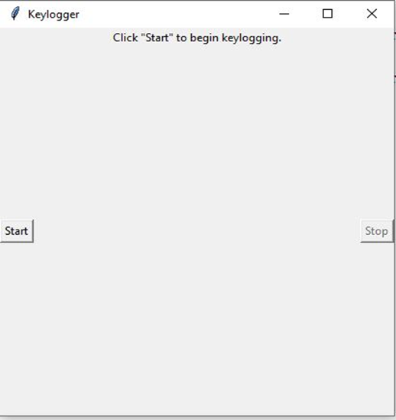
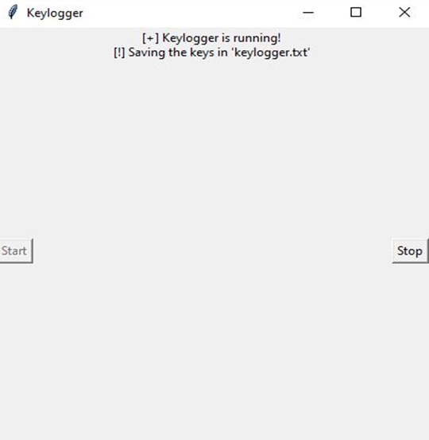
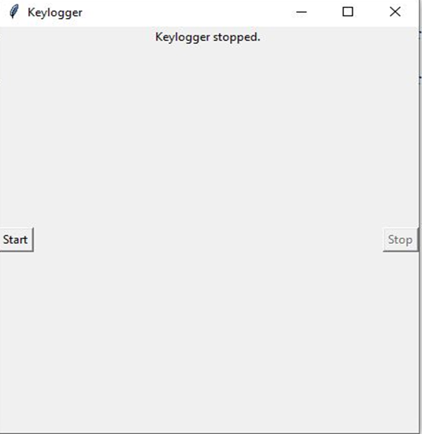
KEYLOGGER UI

Slide 10
CONCLUTION
In conclusion, the implementation of a key logger involves several crucial considerations to ensure its effectiveness, security, and ethical compliance. By capturing keystrokes discreetly and securely, a key logger can serve various purposes, including monitoring user activity for productivity tracking or security purposes. However, it's essential to prioritize user privacy and adhere to legal regulations governing data collection and monitoring practices.
Throughout the implementation process, factors such as data encryption, stealth capabilities, and thorough testing play vital roles in creating a reliable and functional key logger. Additionally, providing clear documentation, user support, and ongoing maintenance are essential for a successful deployment.

Slide 11
FUTURE SCOPE
A key logger is a software tool designed to capture and record keystrokes entered on a computer keyboard. Key logger software typically offers a range of features to effectively monitor user activity, including logging of keystrokes in real-time, capturing screenshots, recording clipboard activity, tracking application usage, and providing detailed reports on user behavior. Additionally, advanced key loggers may offer stealth capabilities to operate discreetly, encryption to secure captured data, and remote monitoring capabilities for real-time access to logged information from anywhere. These features collectively empower key loggers to serve various purposes, including parental control, employee monitoring, cybersecurity analysis, and forensic investigations, while emphasizing user privacy, legal compliance, and data security.

Slide 12
THANK YOU

